Slide 1


Euler’s Method: Tangent Line Approximation
For our first order initial value problem
an alternative is to compute approximate values of the solution y = φ(t) at a selected set of t-values.
Ideally, the approximate solution values will be accompanied by error bounds that ensure the level of accuracy.
In this section, we examine the tangent line method, which is also called Euler’s Method.
$$y^{′}=f(t,y),y(t_{0})=y_{0},$$

Slide 2
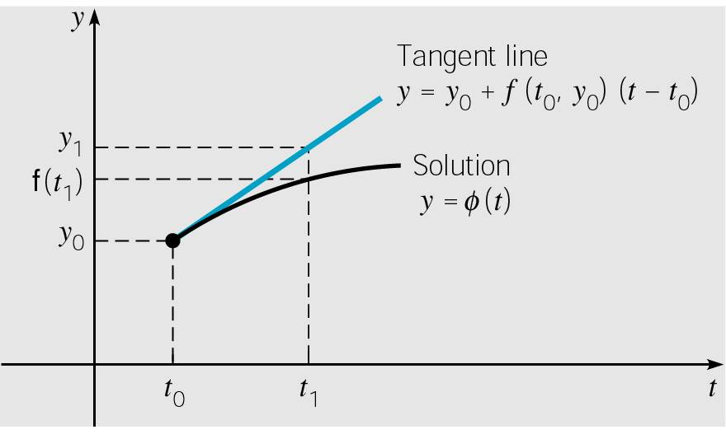



Euler’s Method: Tangent Line Approximation
For the initial value problem
approximating solution: y = φ(t) at initial point t₀.
The line tangent to solution at initial point is thus
Thus if t₁ is close enough to t₀,
we can approximate φ(t₁) by
$$y^{′}=f(t,y),y(t_{0})=y_{0},$$
$$y=y_{0}+f\left(t_{0},y_{0}\right)\left(t−t_{0}\right)$$
$$y_{1}=y_{0}+f\left(t_{0},y_{0}\right)\left(t_{1}−t_{0}\right)$$
Notes:
The solution passes through initial point (t₀, y₀) with slope
f (t₀, y₀).

Slide 3



Euler’s Method: Tangent Line Approximation
For a point t₂ close to t₁, we approximate φ(t₂) using the line passing through (t₁, y₁) with slope f (t₁, y₁):
Thus we create a sequence y_{n} of approximations to φ(t_{n}):
where f_{n} = f (t_{n}, y_{n}).
For a uniform step size h = t_{n} – t_{n-1}, Euler’s formula becomes
$$y_{2}=y_{1}+f\left(t_{1},y_{1}\right)\left(t_{2}−t_{1}\right)$$
$$y_{1}=y_{0}+f_{0}⋅\left(t_{1}−t_{0}\right) \\ y_{2}=y_{1}+f_{1}⋅\left(t_{2}−t_{1}\right) \\ ⋮ \\ y_{n+1}=y_{n}+f_{n}⋅\left(t_{n+1}−t_{n}\right)$$
$$y_{n+1}=y_{n}+f_{n}h,n=0,1,2,…$$

Slide 4
Love Affairs
function dydt = model_love_hate(t,M,a,b)
x= M(1);
y = M(2);
%%% Cautious Lovers %%%
% dx_dt = a*x+b*y;
% dy_dt = b*x+a*y;
%%% Love and Heat%%%
dx_dt = a*y;
dy_dt = -b*x;
dydt = [dx_dt,dy_dt];
end
init = [x0 y0]; % y0 = [v0, w0]
t = linspace(0,10,5000)';
y_euler = zeros(length(t), 2);
y_euler(1, :) = init;
h = t(2)-t(1); % Constant time step
for i = 2:length(t)
k1 =model_love_hate(t(i-1), y_euler(i-1, :),a,b);
y_euler(i, :) = y_euler(i-1, :)+h*k1;
end

Slide 5
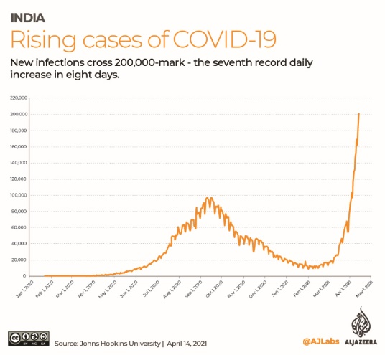

Infection spreading : Modelling

Slide 6
Epidemic Spreading : Modelling
SIS Dynamics
Large population
Single initial case
Rest of the population is fully susceptible

Slide 7
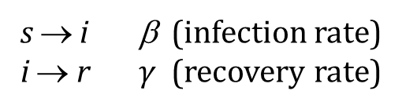



Epidemic Spreading : Modelling
SIS Dynamics
s → i β (infection rate)
i → r $γ$ (recovery rate)
Large population
Single initial case
Rest of the population is fully susceptible
Examples:
Chlamydia
Human papilloma virus
(Respiratory syncytial virus / influenza)
$$\frac{ds}{dt}=γi−βs i$$
$$\frac{di}{dt}=βs i−γi$$
$s+i=1$ (Constant)
Assumptions:
Homogeneous mixing
Constant recovering rate

Slide 8
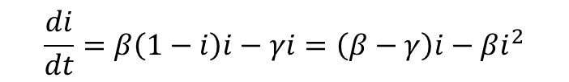




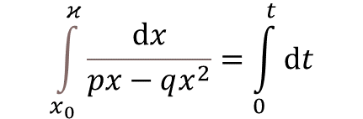
Epidemic Spreading : Modelling
SIS Dynamics
$$\frac{ds}{dt}=γi−βs i$$
$$\frac{di}{dt}=βs i−γi$$
$$\frac{di}{dt}=β\left(1−i\right)i−γi=\left(β−γ\right)i−βi^{2}$$
$s+i=1$ (Constant)
$$\int_{x_{0}}^{κ}{\frac{ⅆx}{px−qx^{2}}}=\int_{0}^{t}{ⅆt}$$
$$p=\left(β−γ\right);q=β$$

Slide 9
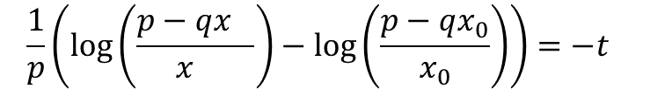
Epidemic Spreading : Modelling
SIS Dynamics
$$\frac{ds}{dt}=γi−βs i$$
$$\frac{di}{dt}=βs i−γi$$
$$\frac{di}{dt}=β\left(1−i\right)i−γi=\left(β−γ\right)i−βi^{2}$$
$s+i=1$ (Constant)
$$\int_{x_{0}}^{κ}{\frac{ⅆx}{px−qx^{2}}}=\int_{0}^{t}{ⅆt}$$
$$p=\left(β−γ\right);q=β$$
$$\frac{1}{p}\left(\log\left(\frac{p−qx_{}}{x_{}}\right)−\log\left(\frac{p−qx_{0}}{x_{0}}\right)\right)=−t$$

Slide 10


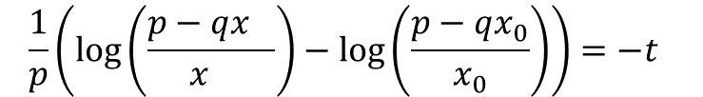
Epidemic Spreading : Modelling
SIS Dynamics
$$\frac{ds}{dt}=γi−βs i$$
$$\frac{1}{p}\left(\log\left(\frac{p−qx_{}}{x_{}}\right)−\log\left(\frac{p−qx_{0}}{x_{0}}\right)\right)=−t$$
$$\frac{di}{dt}=βs i−γi$$
$$p=\left(β−γ\right);q=β$$
$s+i=1$ (Constant)
$$\left(\frac{p−qx_{}}{x_{}}\right)=e^{−pt}(\frac{p−qx_{0}}{x_{0}})$$

Slide 11


Epidemic Spreading : Modelling
SIS Dynamics
$$\frac{ds}{dt}=γi−βs i$$
$$\frac{1}{p}\left(\log\left(\frac{p−qx_{}}{x_{}}\right)−\log\left(\frac{p−qx_{0}}{x_{0}}\right)\right)=−t$$
$$\frac{di}{dt}=βs i−γi$$
$$p=\left(β−γ\right);q=β$$
$s+i=1$ (Constant)
$$\left(\frac{p−qx_{}}{x_{}}\right)=e^{−pt}(\frac{p−qx_{0}}{x_{0}})$$
$$\frac{p}{x}=q+e^{−pt}(\frac{p−qx_{0}}{x_{0}})$$
$$x=\frac{p}{q+e^{−pt}(\frac{p−qx_{0}}{x_{0}}) }$$

Slide 12

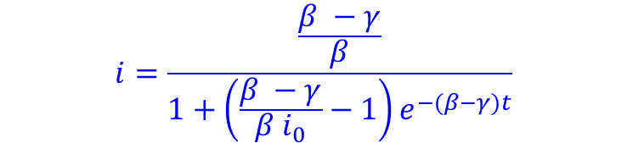
Epidemic Spreading : Modelling
SIS Dynamics
$$\frac{ds}{dt}=γi−βs i$$
$$\frac{di}{dt}=βs i−γi$$
$$p=\left(β−γ\right);q=β$$
$s+i=1$ (Constant)
$$i=\frac{\frac{β −γ}{β}}{1+\left(\frac{β −γ}{β i_{0}}−1\right)e^{−(β−γ)t}}$$
$i_{ee}=\frac{β −γ}{β}$ endemic equilibrium, $t→∞$

Slide 13
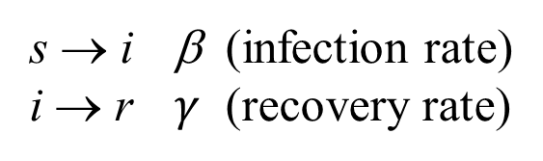


SIR Modelling
s=S/N: density of Susceptible individuals
i=I/N: density of Infective individuals
r=R/N: density of Removed (recovered/dead) individuals
SIR Dynamics
$$\left(\frac{ds}{dt}+\frac{di}{dt}+\frac{dr}{dt}=0\right)$$
s → i β (infection rate)
i → r $γ$ (recovery rate)
$$s+i+r=1$$
Assumptions:
Homogeneous mixing
Constant recovering rate

Slide 14



SIR Modelling
s=S/N: density of Susceptible individuals
i=I/N: density of Infective individuals
r=R/N: density of Removed (recovered/dead) individuals
SIR Dynamics
$$\left(\frac{ds}{dt}+\frac{di}{dt}+\frac{dr}{dt}=0\right)$$
s → i β (infection rate)
i → r $γ$ (recovery rate)
$$\frac{ds}{dt}=−βs i$$
$$s+i+r=1$$
$$\frac{di}{dt}=βs i−γi$$
$$\frac{dr}{dt}=γi$$

Slide 15



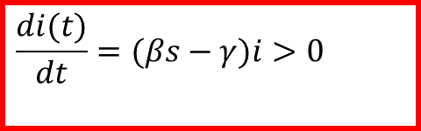
SIR Modelling
s=S/N: density of Susceptible individuals
i=I/N: density of Infective individuals
r=R/N: density of Removed (recovered/dead) individuals
SIR Dynamics
$$\left(\frac{ds}{dt}+\frac{di}{dt}+\frac{dr}{dt}=0\right)$$
s → i β (infection rate)
i → r $γ$ (recovery rate)
$$\frac{ds}{dt}=−βs i$$
$$s+i+r=1$$
$$\frac{di}{dt}=βs i−γi$$
$$\frac{di(t)}{dt}=(βs−γ)i>0$$
$$(s(0)≈1)$$
$$\frac{dr}{dt}=γi$$
$$R_{o}≡\frac{β}{γ}>1$$
$$βs(0)−γ>0$$

Slide 16
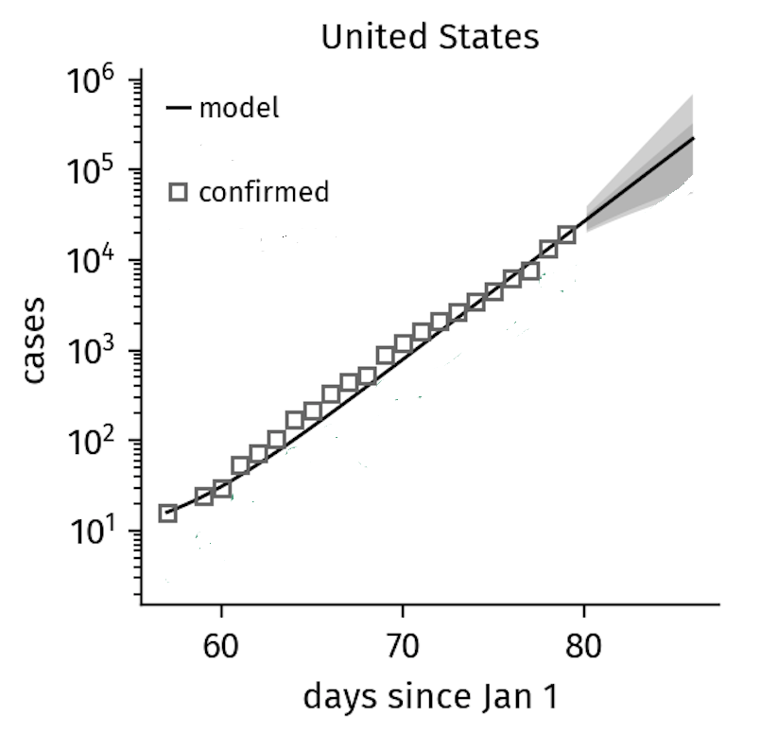
SIR Modelling
SIR Dynamics
$$\frac{ds}{dt}=−βs i$$
$$\frac{di}{dt}=βs i−γi$$
$$\frac{dr}{dt}=γi$$
http://rocs.hu-berlin.de/corona/docs/forecast/model/
Science 368, 742–746 (2020), Maier et al

Slide 17
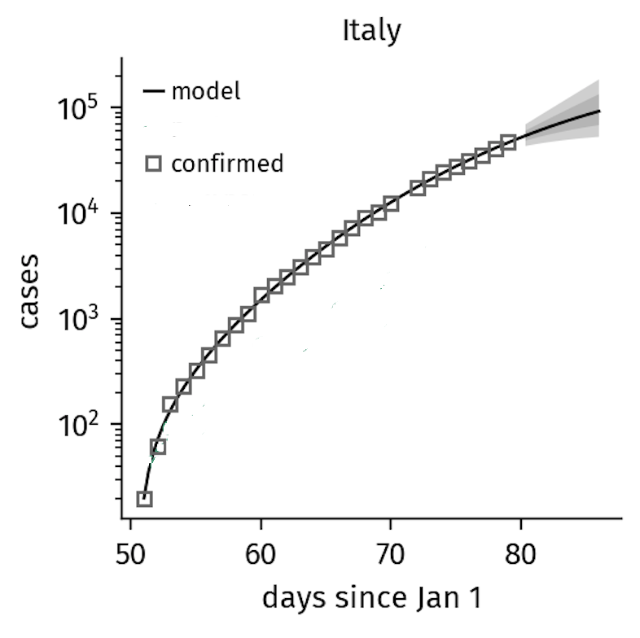


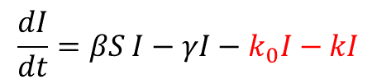

SIR Modelling
SIR-X Dynamics
$$\frac{dS}{dt}=−βSI−k_{0}S$$
$$\frac{dI}{dt}=βS I−γI−k_{0}I−kI$$
$$\frac{dR}{dt}=γI+k_{0}S$$
$$\frac{dX}{dt}=\left(k+k_{0}\right)I$$
Quarantined Individual
http://rocs.hu-berlin.de/corona/docs/forecast/model/
Science 368, 742–746 (2020), Maier et al

Slide 20
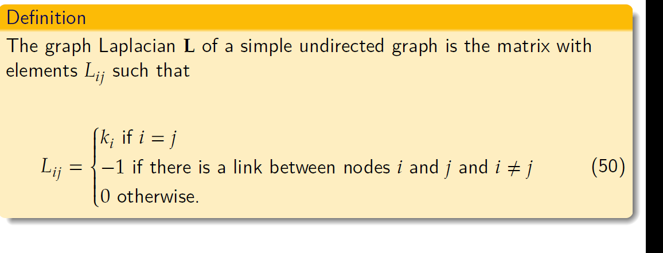
Graph Laplacian

Slide 21
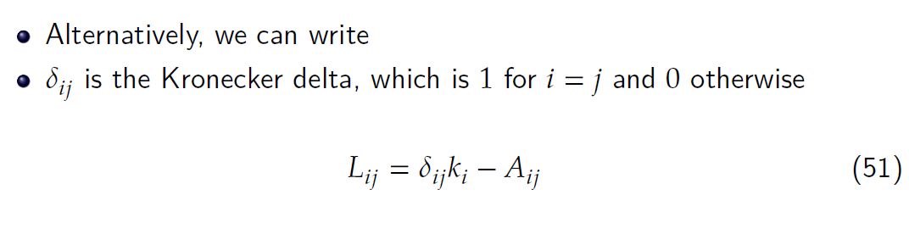
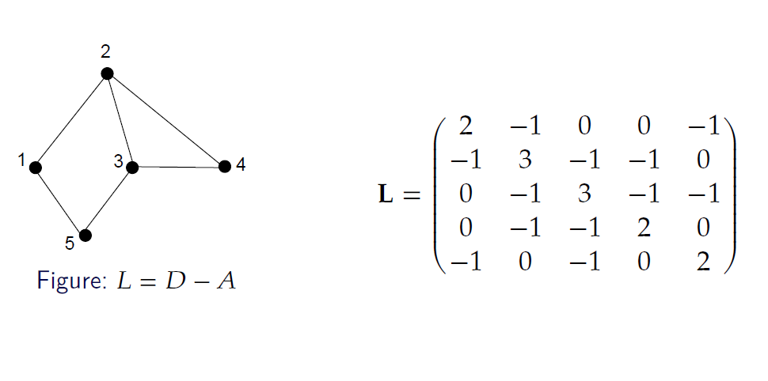
Graph Laplacian

Slide 22
Graph Laplacian

Slide 23
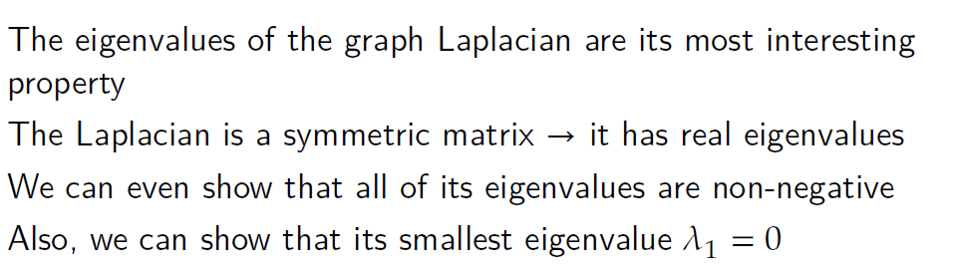
Graph Laplacian

Slide 24
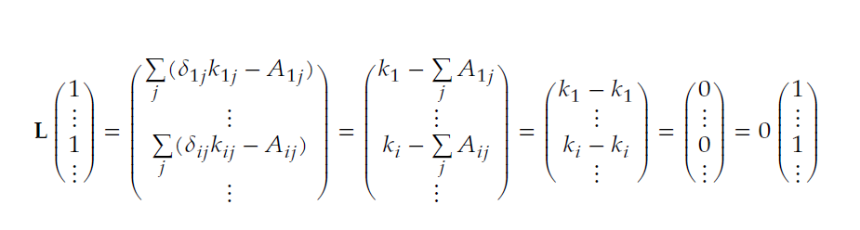
Graph Laplacian

Slide 25
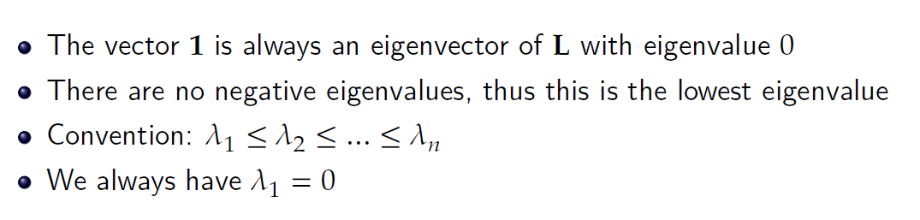
Graph Laplacian

Slide 26
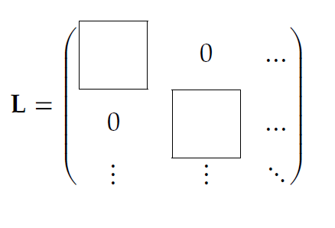
Connected Components and the algebraic connectivity
Suppose we have a network with $c$different components
The components have sizes $n_{1}, n_{2}, … , n_{c}$

Slide 27
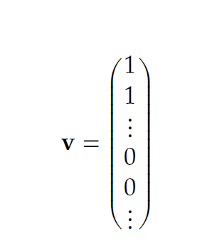
Connected Components and the algebraic connectivity
Suppose we have a network with $c$different components
The components have sizes $n_{1}, n_{2}, … , n_{c}$

Slide 28
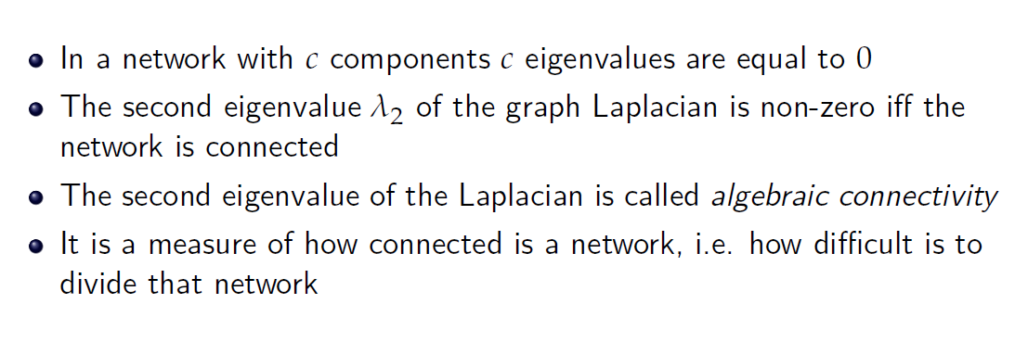
Connected Components and the algebraic connectivity

Slide 29
Dynamics on Networks

Slide 30
Dynamics on Networks: General Model
Denis Helic

Slide 31
Dynamics on Networks: Diffusion Dynamics
Denis Helic

Slide 32
Dynamics on Networks: Diffusion Dynamics
Denis Helic

Slide 33
Dynamics on Networks: Diffusion Dynamics
Denis Helic

Slide 34
Dynamics on Networks: Diffusion Dynamics
Denis Helic

Slide 35
Dynamics on Networks: Diffusion Dynamics
Denis Helic

Slide 36
Dynamics on Networks: Diffusion Dynamics
Denis Helic

Slide 37
Dynamics on Networks: Diffusion Dynamics
Denis Helic

Slide 38
Dynamics on Networks: Diffusion Dynamics
Denis Helic

Slide 39
Dynamics on Networks: Diffusion Dynamics
Denis Helic

Slide 40
Dynamics on Networks: SI model

Slide 41
Dynamics on Networks: SI model
Infected dynamics
Denis Helic

Slide 42
Dynamics on Networks: SI model
Infected dynamics
Denis Helic

Slide 43
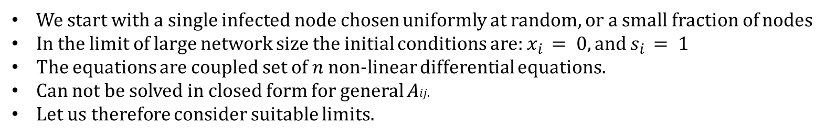
Dynamics on Networks: SI model
We start with a single infected node chosen uniformly at random, or a small fraction of nodes
In the limit of large network size the initial conditions are: $x_{i} = 0, and$ $s_{i} = 1$
The equations are coupled set of 𝑛 non-linear differential equations.
Can not be solved in closed form for general 𝐴𝑖𝑗.
Let us therefore consider suitable limits.
For large $n$ and assuming initial conditions as above $x_{i}$ will be small.
We can ignore terms of quadratic order in small quantities.
Denis Helic

Slide 44
Dynamics on Networks: SI model
Denis Helic

Slide 45


Dynamics on Networks: SI model
$$r=1$$
$$r=1$$
$$r=1$$
Denis Helic

Slide 46

Dynamics on Networks: SI model
$$r=1$$
$$r=1$$
$$r=1$$
Denis Helic

Slide 47
Dynamics on Networks: SI model
Denis Helic

